Slide 1

AuditPCH: Auditable Payment Channel Hub with Privacy Protection
IEEE TIFS 2024
汇报人：赵路路

Slide 2
Outline
Background
Preliminaries
Linkable Randomizable Puzzle Scheme
Auditable Anonymous PCH
Performance Analysis

Slide 3
1 Background

Slide 4
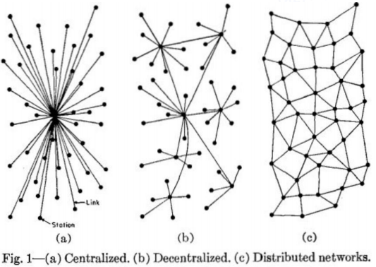
1.1 Payment Channel
Two users open a payment channel and perform off-chain payments by updating the channel state enjoying high payment throughput and low confirmation delay.
If there are more than two users, each pair of users needs to establish their own payment channel to facilitate the payment, which is a non-scalable approach.
Payment Channel Networks (PCN) enable two users with no direct payment channel to pay each other through the channels of some intermediaries.
PCN payments may require multi-channel paths and intermediaries to actively participate in relaying the payments, which can lead to their failure.
Centralized
Decentralized
Distributed

Slide 5
1.2 Challenges in Auditable Anonymous PCH
Atomicity: For any payment of m coins from S to R, the PCH should ensure that either R receives m coins from T and T receives m coins from S, or both parties receive none.
Value Privacy: T should not know the payment amount between S and R.
Relationship Anonymity: T should not be able to find out if there is any relation between S and R of a specific payment.
Griefing Resistance: The PCH should only initiate a payment procedure if R can prove that the payment request are previously backed by some coins locked by a S during the payment procedure.
Illegal Financial Activity Auditability: A should know the relationship of S and R and verify the integrity of payments.

Slide 6
1.3 Abstract
PCH Definition:
Anonymous Payment Channel Hub (PCH), one of the most promising layer-two solutions, settles the scalability issue in blockchain while guaranteeing the unlinkability of transacting parties.
Problem:
Developments bring conflicting requirements, i.e., hiding the sender-to-receiver relationships from any third party but opening the relationship to the auditor. Existing works do not support these requirements simultaneously since off-chain transactions are not recorded in the blockchain.
This work:
The first anonymous PCH solution that provides privacy & auditability.
Linkable randomizable puzzle for conditional transactions.
A novel auditable solution for PCH.
Formal security proof & extensive experiments and evaluation.

Slide 7
2 Preliminaries

Slide 8
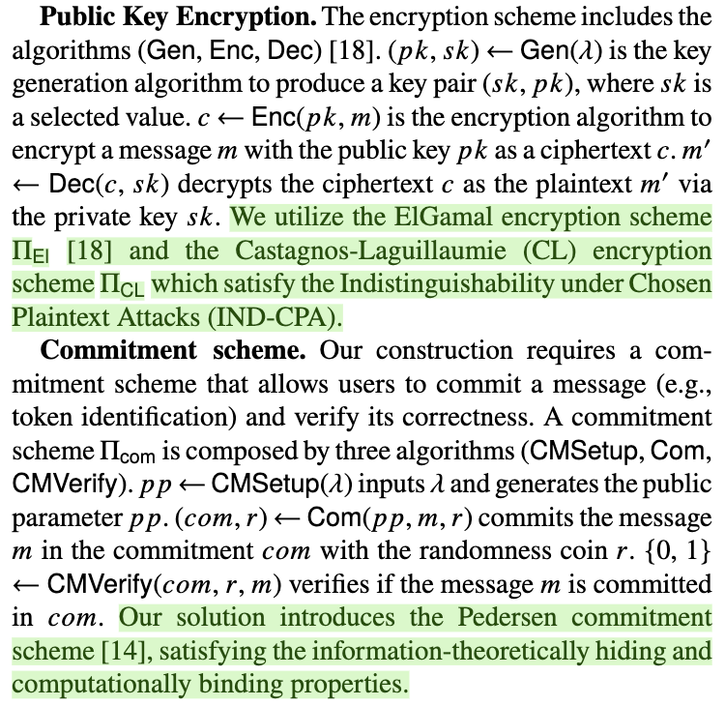
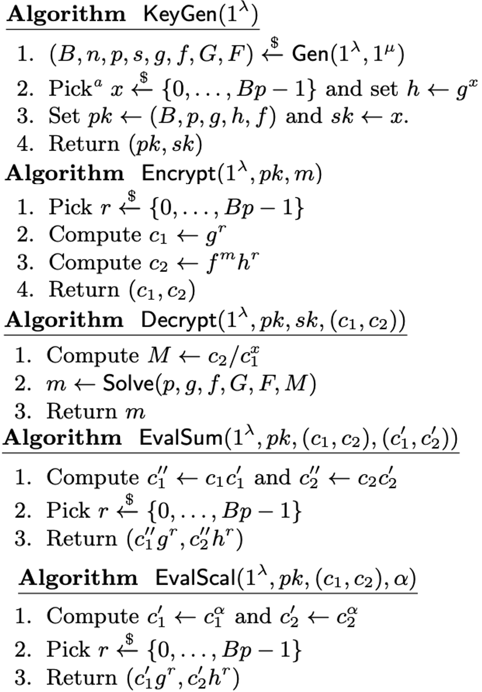
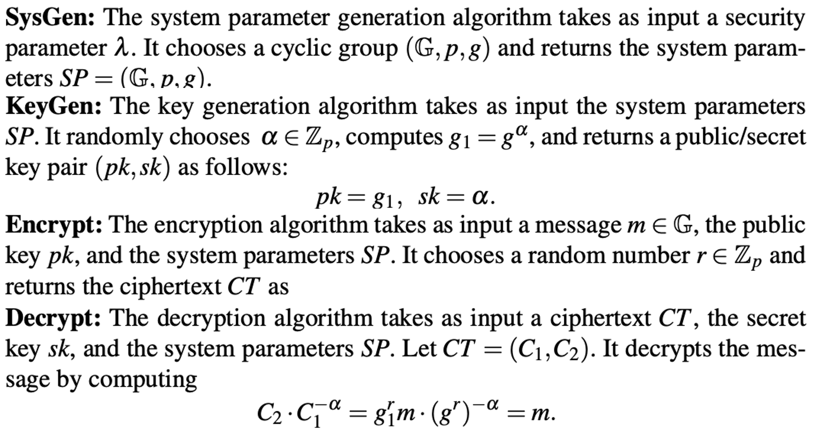
2.1 Public Key Encryption

Slide 9
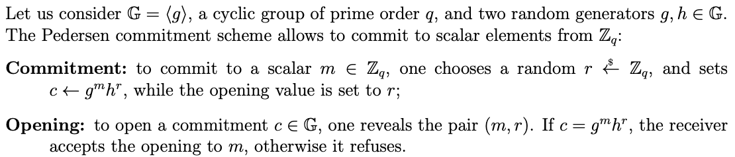
2.2 Commitment Scheme

Slide 10
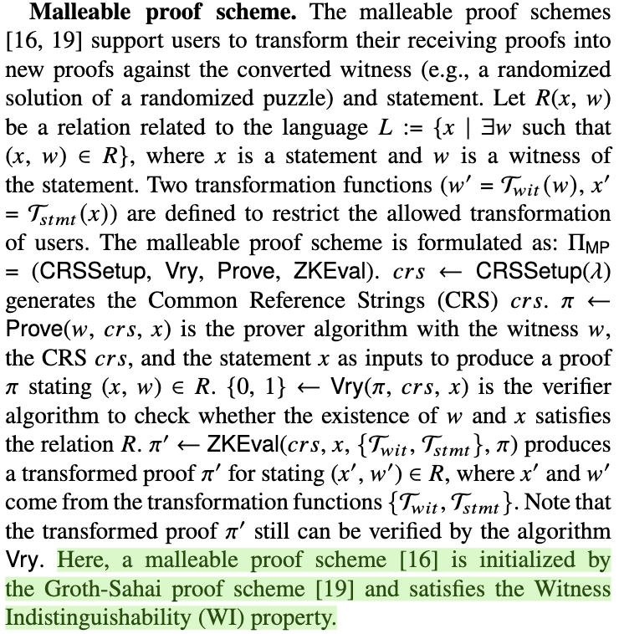
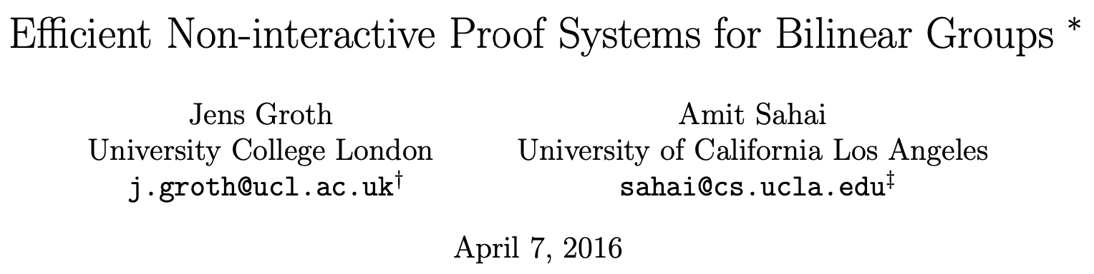
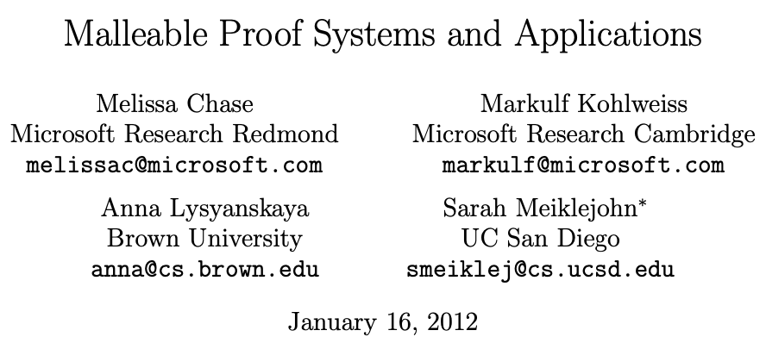
2.3 Malleable Proof Scheme

Slide 11

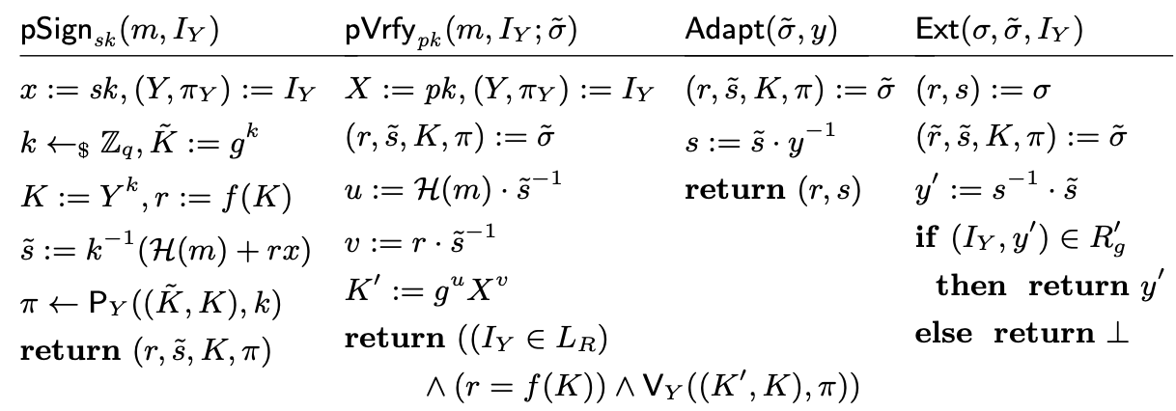
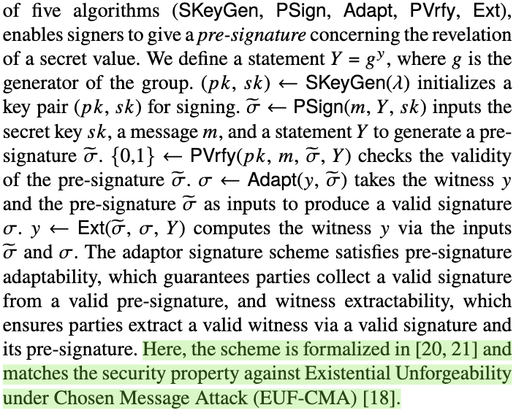
2.4 Adaptor Signature

Slide 12
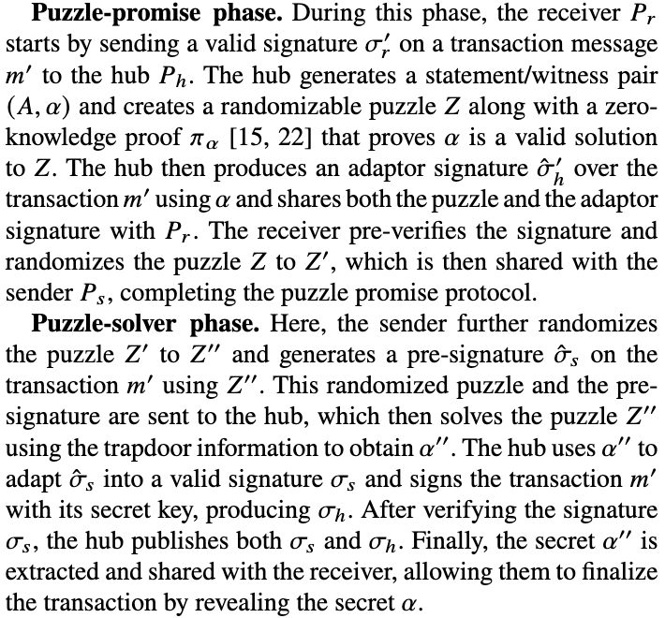
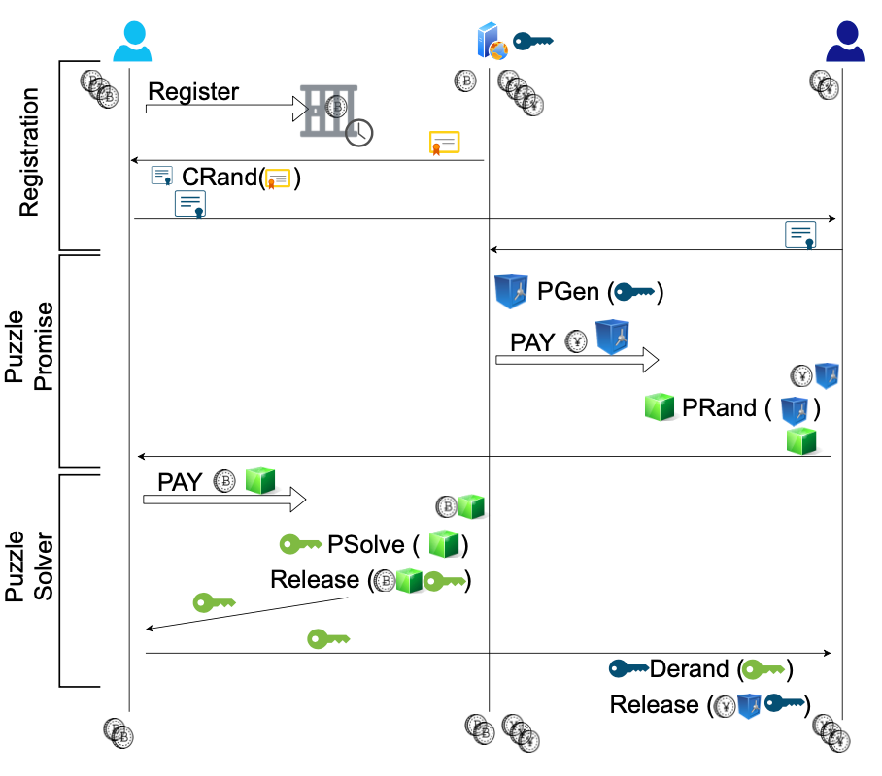
2.5 High-level Design of A²L⁺

Slide 13
3 Linkable Randomizable Puzzle Scheme

Slide 14
3.1 Linkable Randomizable Puzzle Scheme

Slide 15
4 Auditable Anonymous PCH

Slide 16
4.1 Security Model

Slide 17
4.2 Security & Privacy Goals

Slide 18
4.3 GUC-Security Definition

Slide 19
4.4 Auditable Anonymous PCH Overview

Slide 20
5 Performance Analysis

Slide 21
5.1 Performance Analysis

Slide 22
Thanks! Questions?

